Slide 1
Osher Lifelong Learning Institute, Fall 2025
The Economics of Public Policy Issues
University of Minnesota
Host: Geoffrey Woglom, Director
National Economic Education Delegation

Slide 2
National Economic Education Delegation
Vision
  One day, the public discussion of policy issues will be grounded in an accurate perception of the underlying economic principles and data.
Mission
  NEED unites the skills and knowledge of a vast network of professional economists to promote understanding of the economics of policy issues in the United States.
NEED Presentations
  Are nonpartisan and intended to reflect the consensus of the economics profession.

Slide 3
Who Are We?
Honorary Board: 54 members
  2 Fed Chairs: Janet Yellen, Ben Bernanke
  6 Chairs Council of Economic Advisers
    Furman (D), Rosen (R), Bernanke (R), Yellen (D), Tyson (D), Goolsbee (D)
  3 Nobel Prize Winners
    Akerlof, Smith, Maskin
Delegates: 652+ members
  At all levels of academia and some in government service
  All have a Ph.D. in economics
  Crowdsource slide decks
  Give presentations
Global Partners: 48 Ph.D. Economists
  Aid in slide deck development

Slide 4
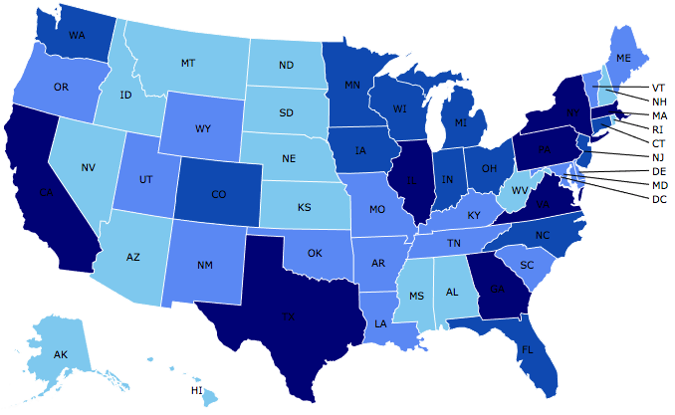
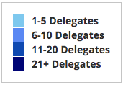
Where Are We?

Slide 5
Available NEED Topics Include:
US Economy
Healthcare Economics
Climate Change
Economic Inequality
Economic Mobility
Trade and Globalization
Minimum Wages
Immigration Economics
Housing Policy
Federal Budgets
Federal Debt
Black-White Wealth Gap
Autonomous Vehicles
US Social Policy

Slide 6
Course Schedule
The Economics of Public Policy Issues
  Week 1 (10/20): Economic Update & Central Bank Independence Geoffrey Woglom, Amherst College
  Week 2 (10/27): Climate Change Economics Sarah Jacobson, Williams College
  Week 3 (11/3) AI and Inequality Geoffrey Woglom, Amherst College
  Week 4 (11/10): Health Care Economics, Robert Rebelein, Vassar College
  Week 5 (11/17): Trade and Globalization, Adina Ardelan, Santa Clara University

Slide 7
How Economists Decide How Much to Fight
Climate Change: Cost Benefit Analysis
Abating greenhouse gas emissions is costly…
… but without action, climate change damages are even more costly.
Goal is not zero emissions, but efficient level that achieves a balance.
Expected costs of reducing emissions
Expected damages from allowing climate change

Slide 8
AI Is Getting “Smarter”
Eloundo, Manning, Mishkin, Rock (2023) https://ar5iv.labs.arxiv.org/html/2303.10130

Slide 9
Health Care Spending as % of GDP, 1980–2018
Everybody Else
Source: Roosa Tikkanen and Melinda K. Abrams, U.S. Health Care from a Global Perspective, 2019: Higher Spending, Worse Outcomes (Commonwealth Fund, Jan. 2020).

Slide 10
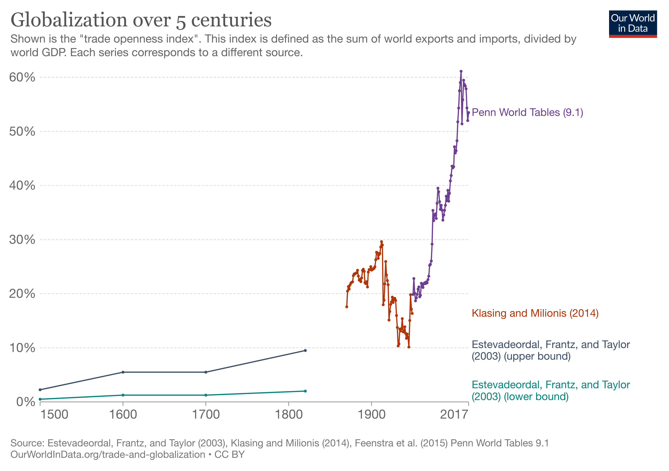

Slide 11
Submitting Questions
Submit questions in the chat. I will try to address questions after 10-minute intervals..
We will do a verbal Q&A once the material has been presented.
Slides will be available from the NEED website tonight https://needecon.org/delivered_presentations.php.
My macro site: https://sites.google.com/view/macro-current-issues/economic-update

Slide 12
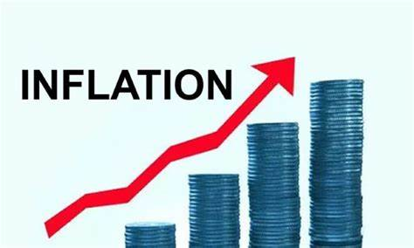
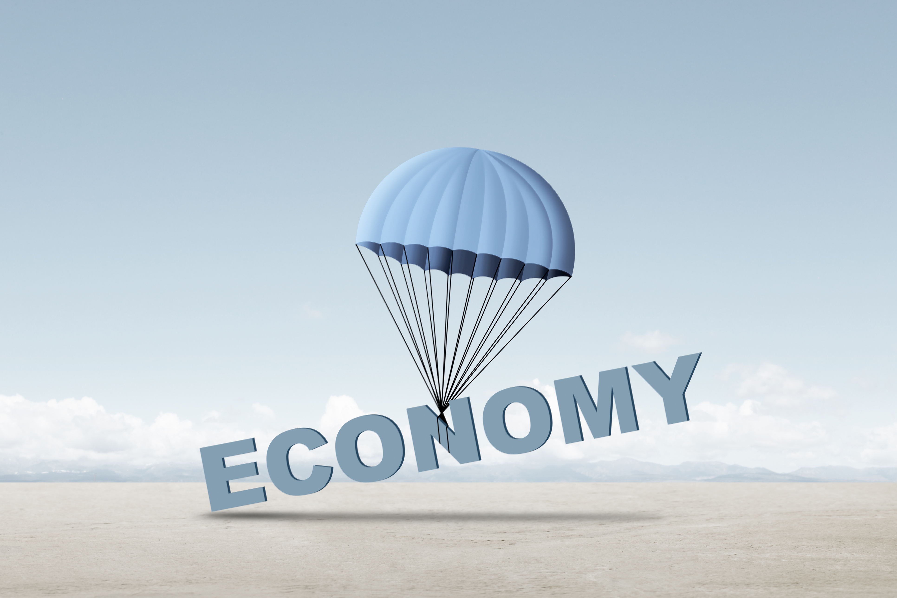
US Economy: Update
Geoffrey Woglom,
Professor of Economics
Amherst College, emeritus
October 20, 2025

Slide 13
Outline for the Talk
Quick Overview of State of the Economy
The Fed’s Current Dilemma
The Importance of Stable Inflationary Expectations.
Central Bank Independence and Inflationary Expectations.

Slide 14
Gross Domestic Product: 2025Q2 = $30.5 tr
$31.4
Less Imports
-$4.2
Plus Exports
+$3.3
Equals GDP
$30.5

Slide 15
Data Issues and the Government Shutdown
Shutdown started on 10/1.
Two major macrodata sources, BLS and BEA, stopped publishing data.
BLS – unemployment and CPI inflation data.
BEA – GDP and the Fed’s preferred inflation measure.
One exception. BLS will publish the on 10/24.

Slide 16
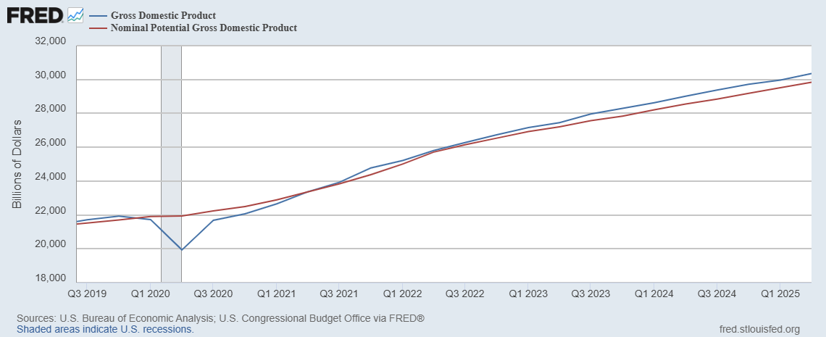
GDP and ‘Potential’ during the Recovery
Grey bar indicates recessions
Source: Fred, St Louis Fed

Slide 17
What is a Recession?
Defined by the National Bureau of Economic Research (NBER)
“The NBER's definition emphasizes that a recession involves a significant decline in economic activity that is spread across the economy and lasts more than a few months.”
Popular Rule of Thumb: Two or more, consecutive quarters where Real GDP falls. (Doesn’t always work!)
Recessions are caused by a drop in total spending (remember the consumer).

Slide 18
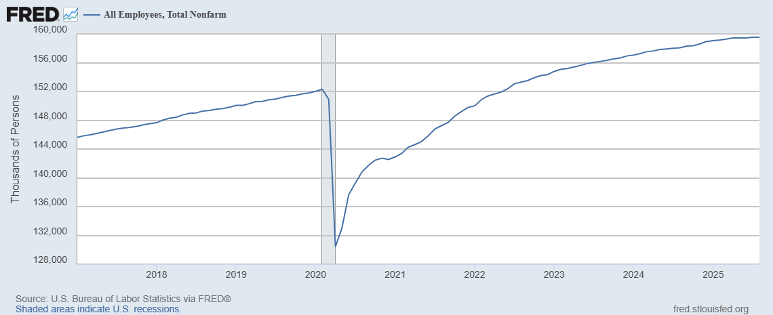
Where Have All the Workers Gone?
Aging of the Labor Force
Also, note the slowing in the growth in jobs
Source: Fred, St Louis Fed

Slide 19
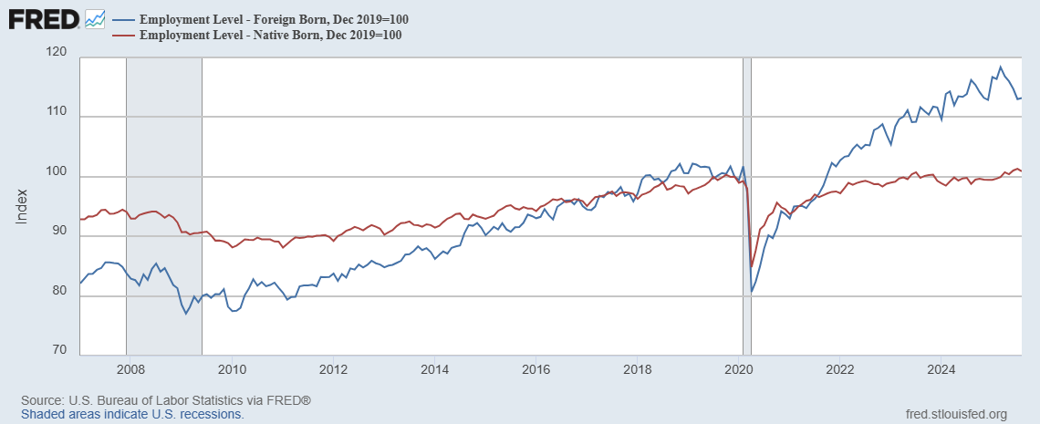
Could Have Been Worse , but for Foreign Born Workers
Between 12/19 and 3/25
NB employment fell by 100k
FB employment rose by 5000k
Since March FB employment
fell by 1400k

Slide 20
New Jobs Added per Month

Slide 21
The Kerfuffle Over the Jobs Reports
BLS conducts 2 surveys each month
  Household Survey: Unemployment Rate.
  “Establishment” Survey (workplace survey): Number of new jobs created.
August 1 Report: 73,000 jobs added July, but May and June numbers were revised down by 280,000.
Trump fires BLS director, the same day.
What is behind those “revisions?”
Want to learn more: “An Unresponsive Public is Undermining Government Economic Data,” WSJ, 9/15, at
https://sites.google.com/view/macro-current-issues/economic-update

Slide 22
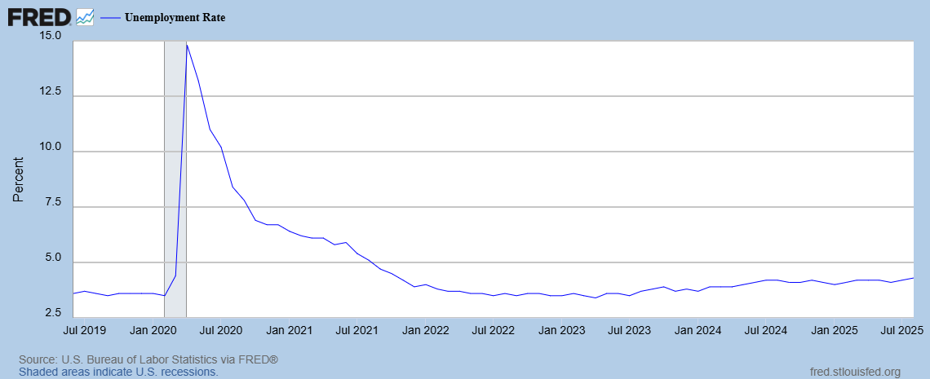
Unemployment is Near Record Lows
But, it has been rising

Slide 23
More Detail on Unemployment

Slide 24
The Real Side of the Economy is Still Good
GDP is very close to its potential.
The labor market as measured by the unemployment rate is fully recovered.
But there are growing signs that the labor market is weakening.
And there are also troubling signs on the nominal side

Slide 25
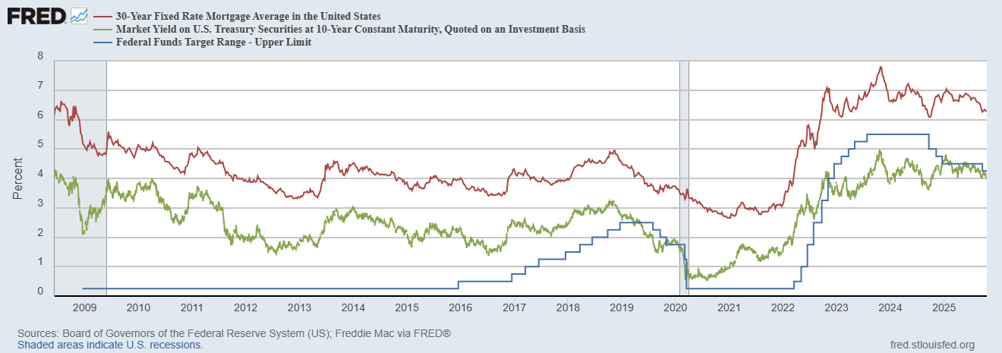
Interest Rates: Era of Falling Rates Over?
Notes:
Fed policy rate 4.5 to 4.25. Concerns with inflation

Slide 26
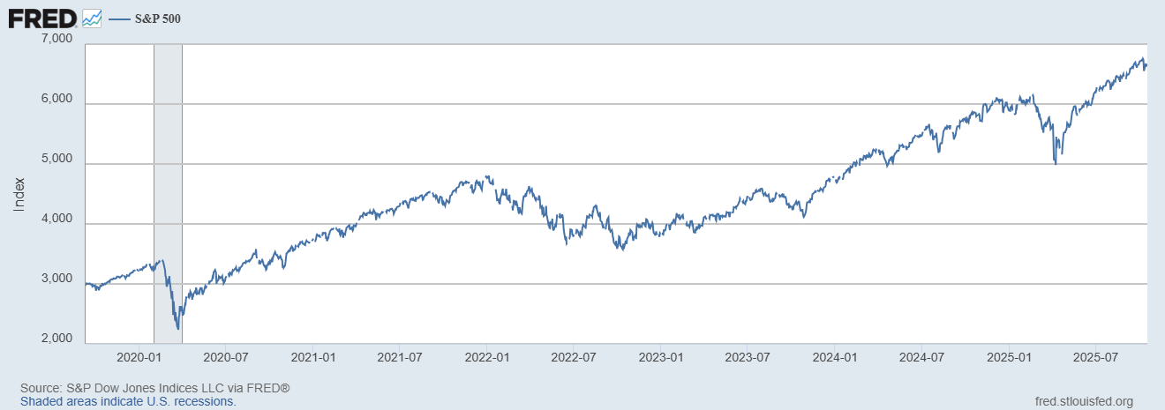
Stock Prices: Tariffs; What Tariffs?
Notes:
Since the end of 2021, lost almost 15%

Slide 27
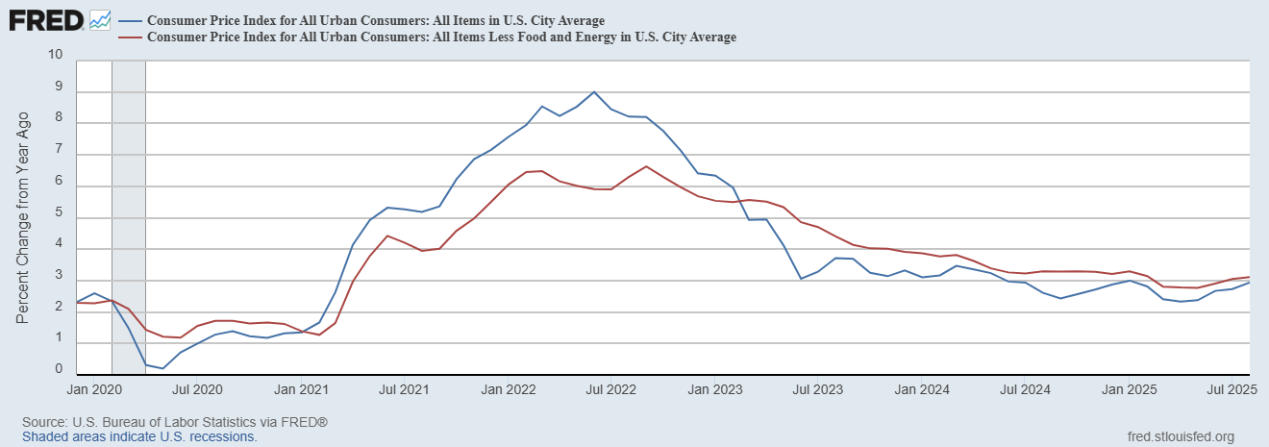
Inflation during the Recovery (CPI)
Notes:
August CPI yoy 8.3% down from 8.5 and Core 6.3 up from 6.3 in JUly

Slide 28
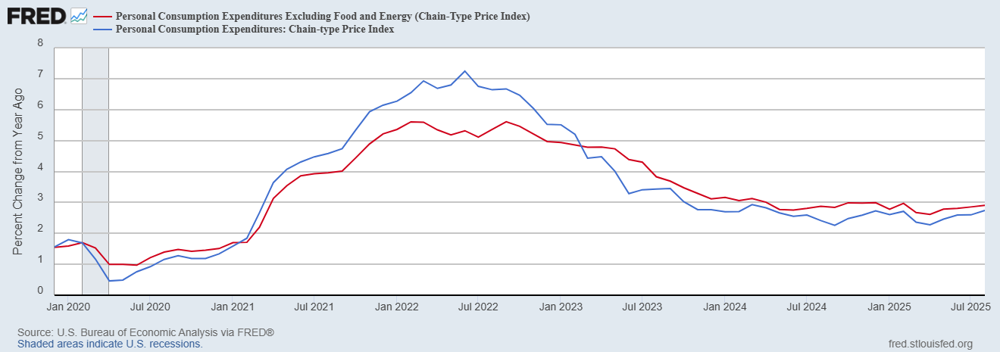
Fed’s Measure (PCE)
Inflation Accelerates 3/2021
Fed Doesn’t React until 3/2022
Progress slows Spring 2024
But so far, not much sign of tariffs in inflation

Slide 29
CPI vs. PCE: Differences
CPI tends typically to be 0.3 pct point higher
August:
CPI, 2.9%
PCE, 2.7%
Core CPI, 3.1%
Core PCE, 2.9%.
https://www.morningstar.com/markets/whats-difference-between-cpi-pce

Slide 30
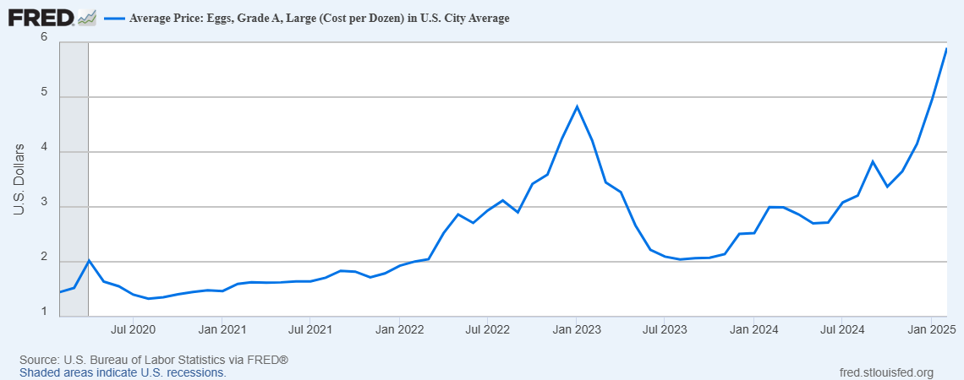
Uses of Inflation Measures
Two Reasons for Measuring Recent Inflation:
What has happened to the Cost of Living?
What is likely to happen to inflation over the next 12-18 months?

Slide 31
The State of the Economy & How We Got Here
The key indicators for judging the macro economy are all good
  Output and unemployment are close to their “full employment” levels
  Inflation is still a bit elevated, but much improved over 2023.
21-22
  Too much demand due to easy monetary policy and a fiscal stimulus which was probably too big
  COVID Supply disruptions exacerbated inflation.
23-present Monetary Policy Perfect
  Inflation has fallen substantially with little increase in unemployment (unprecedented)
But, recent trends are worrying: both inflation and unemployment ticking up

Slide 32
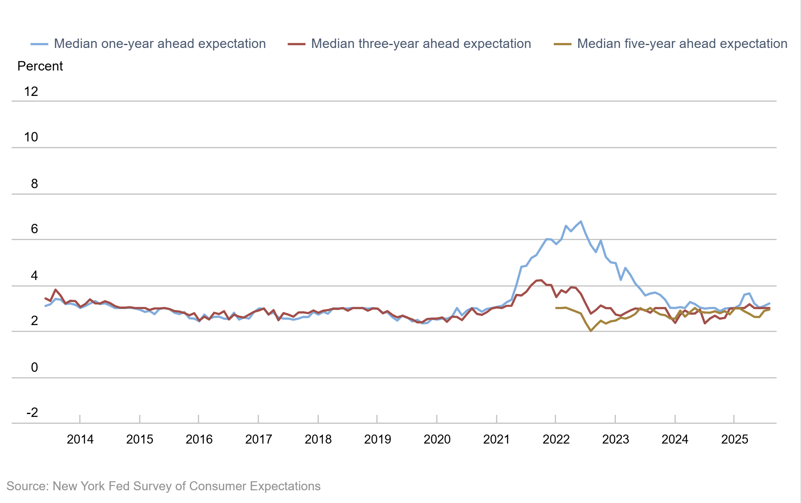
How Did the Fed Do It?
The Key to Success:
Stable Inflationary Expectations

Slide 33
But…
Low-Income Consumers look vulnerable (Tariffs are a regressive tax that hits low-income workers disproportionally)

Slide 34
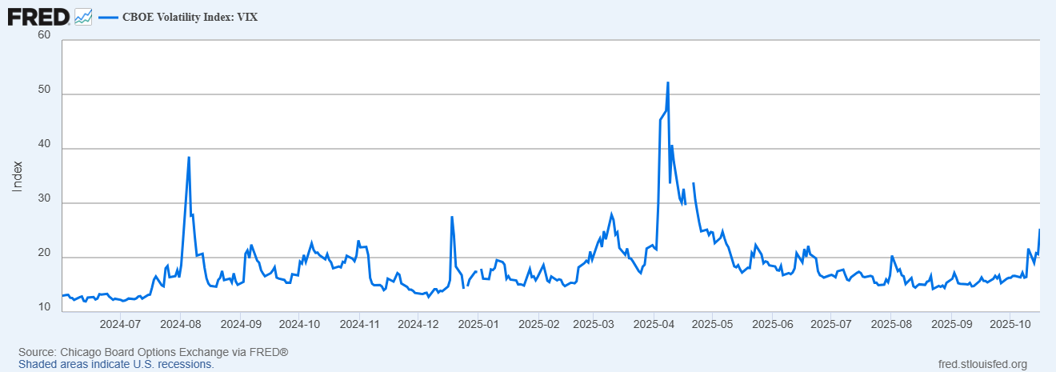
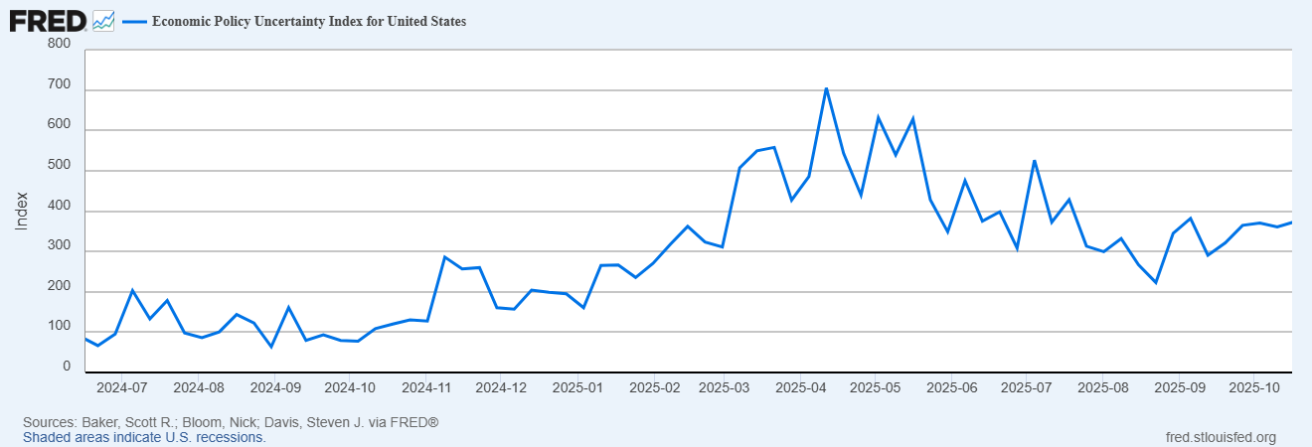
But… (Continued)
Uncertainty is Bad for the Economy’s Health (and there is a lot of it!)

Slide 35
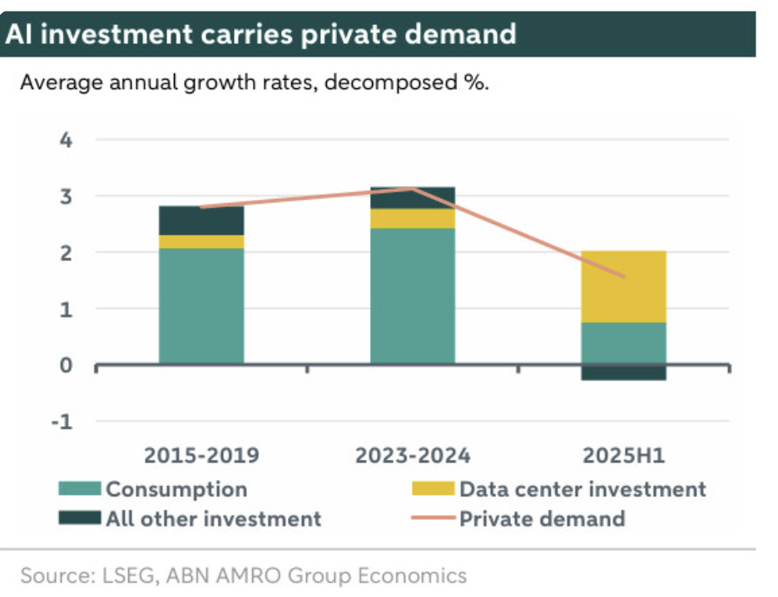
But… (Continued²)
Can AI investment maintain growth?
Government Shutdown?
Labor market look as if it is weakening, particularly for young grads and, blacks.
Inflation above target and appears to be rising; full effect of tariffs has yet to be felt.
The Fed faces a dilemma: stagflation, viz., rising unemployment and inflation

Slide 36
The Fed’s Dilemma
To combat rising unemployment the Fed needs to lower interest rates to increase demand and spending.
To combat rising inflation the Fed needs to raise interest rates to lower demand and spending.
Successfully navigating the path between the two problems is made worse because of attacks on the Fed’s independence which have the potential to destabilize inflationary expectations

Slide 37
What the Fed Did at Its Last Meeting

Slide 38
Central Bank Independence
Monetary Policy interest rate decisions are made by the Fed (FOMC) and cannot be reversed by other branches of government.
Federal Reserve Governors have 14-year terms.
The Chair (Jerome Powell) serves a 4-year term (which will be up next spring).
The Fed’s expenses are financed from operations; it doesn’t have to go to Congress for appropriation
The Fed is accountable to Congress and the public by:
  Congress Sets the “Dual Mandate” (but not numerical targets).
  Chair testifies to Congress.
  Policy Statement issued and Chair Press Conference after Policy meeting
  Current Policy deliberations are made available with a 6-week lag.
  All policy discussions are released with a 5-year lag.

Slide 39
Theoretical Case for Independent and Conservative Central Banks
Keneth Rogoff’s Conservative Central Banker paper (1985):
“Society can sometimes make itself better off by appointing a central banker who does not share the social objective function, but instead places "too large" a weight on inflation-rate stabilization relative to employment stabilization.”
Independent “conservative” central bank leads to “well-anchored” and lower inflationary expectations.

Slide 40
Paul Volcker: Rogoff’s Muse
Volcker become Fed Chair
Volcker achieved Fed “Credibility” that it would lower inflation and keep it low. (at a substantial cost)

Slide 41
Evidence: The Low-Inflation Free Lunch
Fig. 2b Variability of Real GNP
Alesina, A., and L. Summers. “Central Bank Independence and Macroeconomic Performance
: Some Comparative Evidence.” Journal of Money, Credit and Banking 25, no. 2 (1993): 151–62.
https://doi.org/10.2307/2077833.

Slide 42
Practical Effects of this Research
Countries adopt strict inflation targeting: New Zealand (1989), Canada (1991), UK (1992), Australia and Sweden (1993)
Tony Blair’s first action as UK Prime Minister in 1997 is to remove Chancellor of the Exchequer from the Bank of England.
Eurozone created 2002 which places monetary policy out of the hands of nations’ central banks and into the hands of The European Central Bank (ECB).
Where is the ECB located?
Frankfurt Germany!

Slide 43
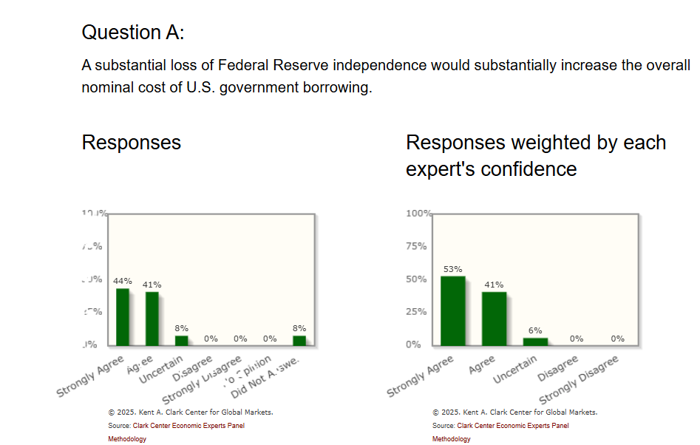
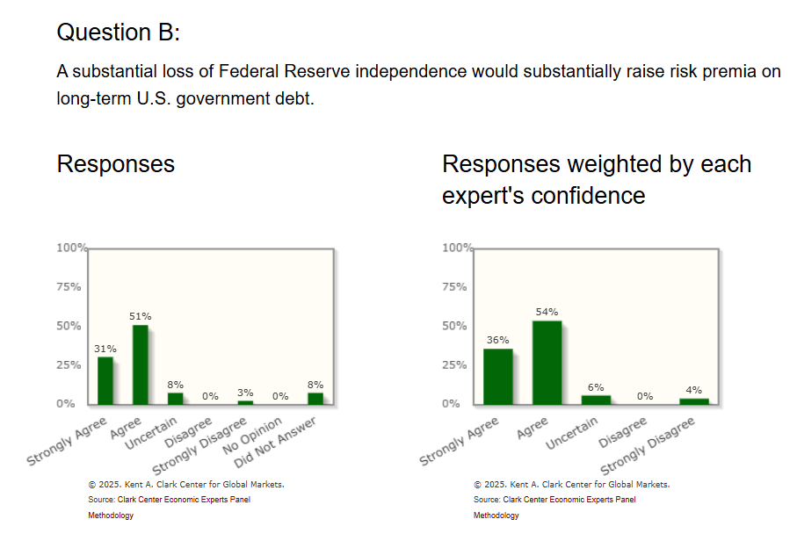
Who Says Economist Always Disagree?
https://kentclarkcenter.org/surveys/fed-independence/

Slide 44
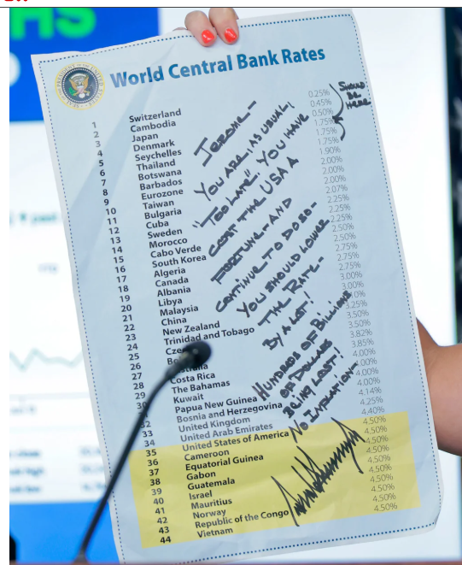
This Doesn’t Help
The irony is that the Fed would be able to lower interest rates more aggressively with no attacks.
If it appears the Fed is caving to political pressure, it will lose credibility and increase inflationary expectations.

Slide 45
An Unresolved Issue
Is Central Bank Independence Consistent with Democracy?
Things to think about: The Fed through monetary policy has the most influence on the short-run behavior of the economy. These governmental decisions are made “technocratically” and not democratically.
In the current situation should the democratic process have input in how the Fed deals with the dilemma of stagflation?

Slide 46
My Google Site
https://sites.google.com/view/macro-current-issues/economic-update

Slide 47
Next Week: Climate Change Economics
Abating greenhouse gas emissions is costly…
… but without action, climate change damages are even more costly.
Goal is not zero emissions, but efficient level that achieves a balance.
Expected costs of reducing emissions
Expected damages from allowing climate change

Slide 48
Let’s Hear from You!
Geoffrey Woglom grwoglom@amherst.edu
Contact NEED: Info@NEEDEcon.org
Support NEED: www.NEEDEcon.org/donate.php

